Slide 1
Pre-Test Review Game Get out a blank sheet of notebook paper! Number it 1-25 Put away all electronics!

Slide 2
Rules
No electronics.
No taking pictures of the slides.
No talking/sharing answers.
Write your answer on your paper.

Slide 3
1. Which is NOT a reactant in photosynthesis?
Carbon Dioxide
Glucose
Light Energy
Water

Slide 4
2. How are photosynthesis and respiration complementary reactions?
Photosynthesis makes what respiration needs
Respiration makes what photosynthesis needs
They are both always happening in a connected cycle
All of the above

Slide 5
3. Which of the following is considered a producer?
Rabbit
Human
Vulture
Oak tree

Slide 6
4. C₆H₁₂O₆ is :
sucrose
glucose
Carbon hydroxide

Slide 7
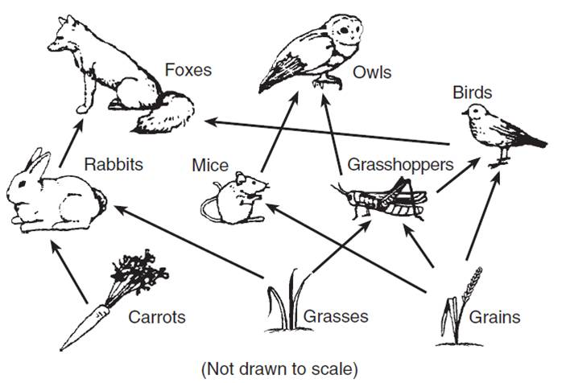
5. According to this food web, what two organisms does the fox eat?

Slide 8
6. Put the following statements in chronological order:
Water enters the chloroplast
Roots take in water from the soil
Water enters the leaf
Water travels up the stem

Slide 9
7. What is the main source of energy for all of life on Earth?
bacteria
decomposers
producers
sun

Slide 10
8. During respiration, food energy is turned into chemical energy called:
GTP
ABP
GBP
ATP

Slide 11
9. Which of the following is considered a carnivore?
lady bug
human
tiger
giraffe

Slide 12
10. Which is not a product of respiration?
Carbon dioxide
ATP
Light energy
Water

Slide 13
11. Organisms that feed on dead/decaying remains of other organisms are called:
producers
consumers
decomposers
scavengers

Slide 14
12. CO₂ is :
Carbon monoxide
oxygen
Carbon dioxide

Slide 15
13. Which of the following is the correct equation for respiration?
C₆H₁₂O₆ + 6O₂ → 6H₂O + energy (ATP)
C₆H₁₂O₆ + 6CO₂ → 6H₂O + energy (ATP)
C₆H₁₂O₆ + 6O₂ → 6CO₂ + 6H₂O + energy (ATP)
C₆H₁₂O₆ + 6CO₂ → 6O₂ + 6H₂O + energy (ATP)

Slide 16
14. What part of the cell does respiration occur in?
chloroplast
cytoplasm
Golgi apparatus
mitochondria

Slide 17
15. Put the following categories in chronological order from the beginning of the food chain to the end:
Producers
Decomposers
Consumers
Sun

Slide 18
16. Organisms depend on plants for two primary reasons. What are they?

Slide 19
17. Organisms that eat only producers are called:
herbivores
carnivores
omnivores

Slide 20
18. Which of the following is considered an herbivore?
horse
raccoon
fox
squirrel

Slide 21
19. What part of the cell does photosynthesis occur in?
chloroplast
cytoplasm
Golgi apparatus
mitochondria

Slide 22
20. Which of the following is the correct equation for photosynthesis?
6O₂ + 6H₂O + light → C₆H₁₂O₆+ 6CO₂
6CO₂ + 6O₂ + light → C₆H₁₂O₆+ 6H₂O
6CO₂ + 6H₂O + light → C₆H₁₂O₆+ 6O₂
6CO₂ + 6H₂O + light → C₆H₁₂O₆+ 6H₂O

Slide 23
21. Organisms that eat both consumers and producers are called:
herbivores
carnivores
omnivores

Slide 24
22. Which of the following is considered a omnivore?
grasshopper
pig
sunflower
cheetah

Slide 25
23. How much energy is passed up the food chain at each level?
90%
70%
1%
10%

Slide 26
24. Organisms that eat only consumers are called:
herbivores
carnivores
omnivores

Slide 27
25. Organisms that break down dead/decaying remains of other organisms are called:
producers
consumers
decomposers
scavengers

Slide 28
Which is NOT a reactant in photosynthesis?
Carbon Dioxide
Glucose
Light Energy
Water

Slide 29
How are photosynthesis and respiration complementary reactions?
Photosynthesis makes what respiration needs
Respiration makes what photosynthesis needs
They are both always happening in a connected cycle
All of the above

Slide 30
Which of the following is considered a producer?
Rabbit
Human
Vulture
Oak tree

Slide 31
C₆H₁₂O₆ is :
sucrose
glucose
Carbon hydroxide

Slide 32
According to this food web, what two organisms does the fox eat?
Birds and rabbits

Slide 33
Put the following statements in chronological order: (assign each letter a # 1-4)
Water enters the chloroplast 4
Roots take in water from the soil 1
Water enters the leaf 3
Water travels up the stem 2

Slide 34
What is the main source of energy for all of life on Earth?
bacteria
decomposers
producers
sun

Slide 35
During respiration, food energy is turned into chemical energy called:
GTP
ABP
GBP
ATP

Slide 36
Which of the following is considered a carnivore?
lady bug
human
tiger
giraffe

Slide 37
Which is not a product of respiration?
Carbon dioxide
ATP
Light energy
Water

Slide 38
Organisms that feed on dead/decaying remains of other organisms are called:
producers
consumers
decomposers
scavengers

Slide 39
CO₂ is :
Carbon monoxide
oxygen
Carbon dioxide

Slide 40
Which of the following is the correct equation for respiration?
C₆H₁₂O₆ + 6O₂ → 6H₂O + energy (ATP)
C₆H₁₂O₆ + 6CO₂ → 6H₂O + energy (ATP)
C₆H₁₂O₆ + 6O₂ → 6CO₂ + 6H₂O + energy (ATP)
C₆H₁₂O₆ + 6CO₂ → 6O₂ + 6H₂O + energy (ATP)

Slide 41
What part of the cell does respiration occur in?
chloroplast
cytoplasm
Golgi apparatus
mitochondria

Slide 42
Put the following categories in chronological order from the beginning of the food chain to the end: (assign each letter a # 1-4)
Producers 2
Decomposers 4
Consumers 3
Sun 1

Slide 43
Organisms depend on plants for two primary reasons. What are they?
1- food source (initial source of glucose/energy)
2- oxgyen

Slide 44
Organisms that eat only producers are called:
herbivores
carnivores
omnivores

Slide 45
Which of the following is considered an herbivore?
horse
raccoon
fox
squirrel

Slide 46
What part of the cell does photosynthesis occur in?
chloroplast
cytoplasm
Golgi apparatus
mitochondria

Slide 47
Which of the following is the correct equation for photosynthesis?
6O₂ + 6H₂O + light → C₆H₁₂O₆+ 6CO₂
6CO₂ + 6O₂ + light → C₆H₁₂O₆+ 6H₂O
6CO₂ + 6H₂O + light → C₆H₁₂O₆+ 6O₂
6CO₂ + 6H₂O + light → C₆H₁₂O₆+ 6H₂O

Slide 48
Organisms that eat both consumers and producers are called:
herbivores
carnivores
omnivores

Slide 49
Which of the following is considered a omnivore?
grasshopper
pig
sunflower
cheetah

Slide 50
How much energy is passed up the food chain at each level?
90%
70%
1%
10%

Slide 51
Organisms that eat only consumers are called:
herbivores
carnivores
omnivores

Slide 52
25. Organisms that break down dead/decaying remains of other organisms are called:
producers
consumers
decomposers
scavengers

